Slide 1
CS 111 Operating Systems
Week 4
01/31/2020
Nikita Sivakumar

Slide 2
Things we are going to discuss:
Overview of Project 4A:The Big Picture
Discuss Sample Midterm
Discuss Solutions in class (through participation)
Review some of the topics
I will not be posting the solutions

Slide 3
And as you know:
Project 4A
Spec: http://web.cs.ucla.edu/~harryxu/courses/111/winter20/ProjectGuide/P4A.html
Due on Wednesday (02/05/2020) at 11:59 PM
Late Policy : Exponential as discussed previously
Please remember to download your submissions and check if you submitted the correct files. Empty submissions - or submissions in the wrong format - cannot be graded and will therefore be scored with a 0
Midterm is going to be held on 5th February, 2020 in class

Slide 4
Sample Midterm Topics Reviewed
A scheduling question
IPC mechanisms
Shared Memory
Socket
Others
ABI’s
Spin Locks
Semaphores
Internal and External Fragmentation in Paging

Slide 5
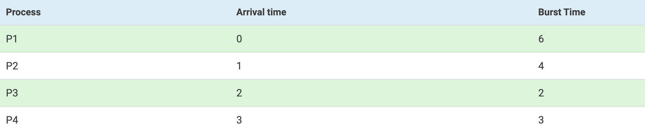
Scheduling Question
Let’s do Preemptive shortest job first on this:
Describe the Gantt Chart, Wait times, and Turnaround times.

Slide 6
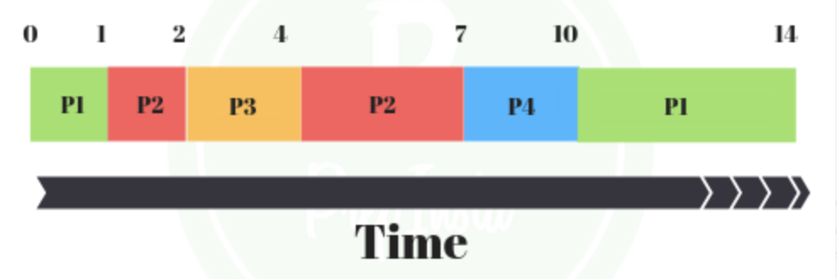
Solution
Gantt Chart:

Slide 7
IPC
The whole point of IPC – or Inter Process Communication – is to provide efficient and flexible message passing communication mechanisms between processes.
These are the five primary IPC mechanisms available.

Slide 8
Sockets :Processes can connect using TCP/IP or UDP sockets and exchange data over the sockets.
Pipes: A pipe is used for one way communication of a stream of bytes.
Shared Memory: When a single block of memory in the address space is shared by two or more processes then that is considered to be shared memory. If one process changes this shared memory then that change is visible to all of the other processes with access to the shared memory.
Message Queues: With message queues, one or more processes can write messages, which can in turn be read by one or more reading processes.
Signals: Signals are one of the oldest interprocess communication methods, and are used by Unix systems. They are used to signal asynchronous events to one or more processes.

Slide 9
Application Binary Interface (ABI)
One easy way to understand "ABI" is to compare it to "API".
You are already familiar with the concept of an API. If you want to use the features of, say, some library or your OS, you will use an API. The API consists of data types/structures, constants, functions, etc that you can use in your code to access the functionality of that external component.
An ABI is very similar:
Think of it as the compiled version of an API (or as an API on the machine-language level). When you write source code, you access the library through an API.
Once the code is compiled, your application accesses the binary data in the library through the ABI.
The ABI defines the structures and methods that your compiled application will use to access the external library (just like the API did), only on a lower level.

Slide 10
Spin Locks
A spinlock is a lock which causes a thread trying to acquire it to simply wait in a loop ("spin") while repeatedly checking if the lock is available.
Say a resource is protected by a lock ,a thread that wants access to the resource needs to acquire the lock first. If the lock is not available, the thread might repeatedly check if the lock has been freed. During this time the thread busy waits, checking for the lock, using CPU, but not doing any useful work. Such a lock is termed as a spin lock
Basically, it's a loop that spins around until a condition is met.

Slide 11
Semaphores
A simple way to understand wait (P) and signal (V) operations is:
wait: Decrements the value of semaphore variable by 1. If the new value of the semaphore variable is negative, the process executing wait is blocked (i.e., added to the semaphore's queue). Otherwise, the process continues execution, having used a unit of the resource.
signal: Increments the value of semaphore variable by 1. After the increment, if the pre-increment value was negative (meaning there are processes waiting for a resource), it transfers a blocked process from the semaphore's waiting queue to the ready queue.

Slide 12
External and Internal Fragmentation
External fragmentation occurs when we have a memory to accommodate a process but it's not continuous
Internal fragmentation happens when the memory is split into mounted sized blocks. Whenever a method request for the memory, the mounted sized block is allotted to the method. Just in case the memory allocated to the method is somewhat larger than the memory requested, then the distinction between allotted and requested memory is that the Internal fragmentation

Slide 13
Internal Fragmentation and Paging
Why is there internal fragmentation with paging?
Because a page has fixed size, but processes may request more or less space. Say a page is 32 units, and a process requests 20 units. Then when a page is given to the requesting process, that page is no longer useable despite having 12 units of free "internal" space.

Slide 14
External Fragmentation and Paging
Why is there no external fragmentation with paging?
External frag occurs when a process, which was allocated contiguous memory, is unloaded from physical memory, which creates a hole (free space ) in the memory. Now if a new process comes, which requires more memory than this hole, then we won't be able to allocate contiguous memory to that process due to non contiguous nature of free memory, this is called external fragmentation
Essentially, paging divides virtual memory or all processes into equal-sized pages and physical memory into fixed size frames. So you are typically fixing equal size blocks called pages into equal block shaped spaces called frames!

Slide 15
Thank you!

